Slide 1
TUGAS ARSIKOM DEVICES & BENTUK SISTEM ARSITEKTURNYA
ACER NITRO 5 & Iphone 13

Slide 2

LAPTOP ACER NITRO 5
Nitro AN515-58

Slide 3
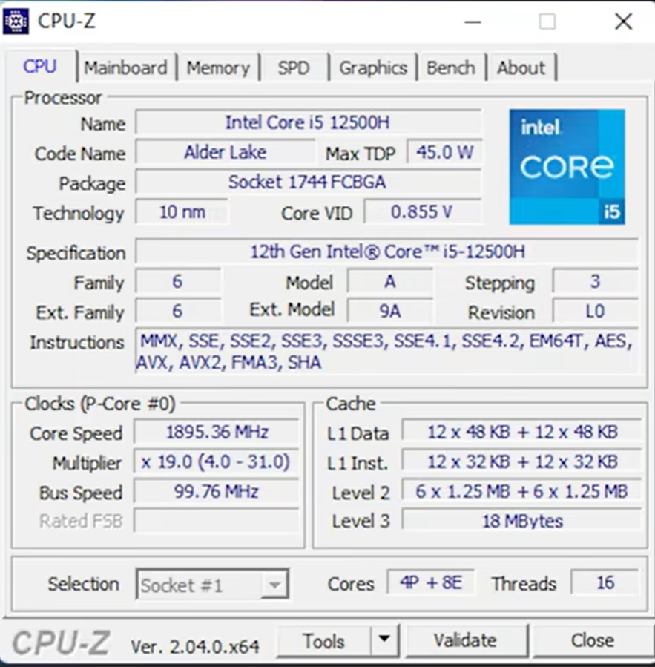
Spesifikasi Laptop Acer Nitro 5
CPU
Intel® Core™ i5-12500H Processor
Fabrikasi Intel 7
Base TDP 45W
Total 12-Cores/16 Thread
4 Performance Cores
8 Efficient Cores
Max Turbo Frequency 4.5 GHz
18 MB Intel Smart Cache

Slide 4
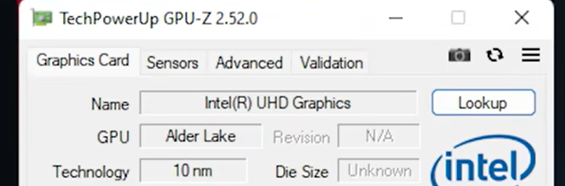
Graphics
Intel® UHD Graphics
Saat RAM Single-Chanel

Slide 5
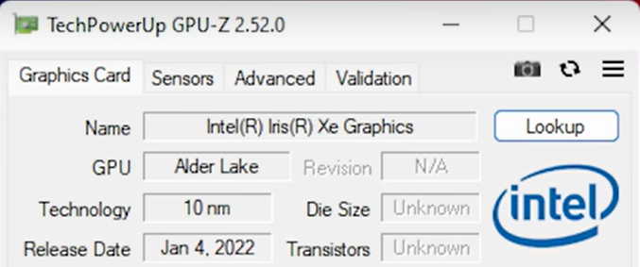
Graphics
Intel® Iris® Xe Graphics
80 Execution Units
Didukung Akselersi QSV dan AV1
Saat RAM Dual-Chanel

Slide 6
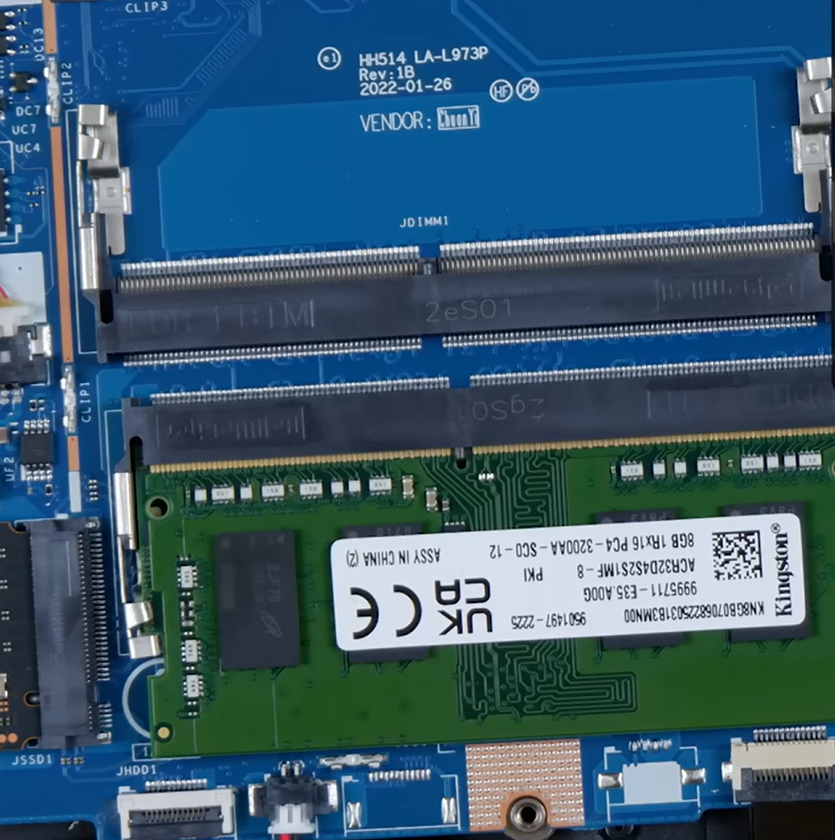
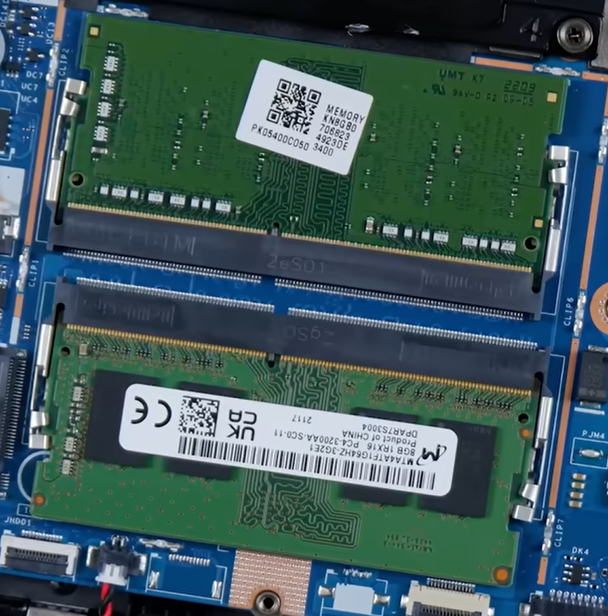
Ram
8 GB DDR4-3200 SODIMM
Tersedia slot SODIMM Kedua
Mudah Di-Upgrade
Konfigurasi Single Chanel
Upgrade

Slide 7
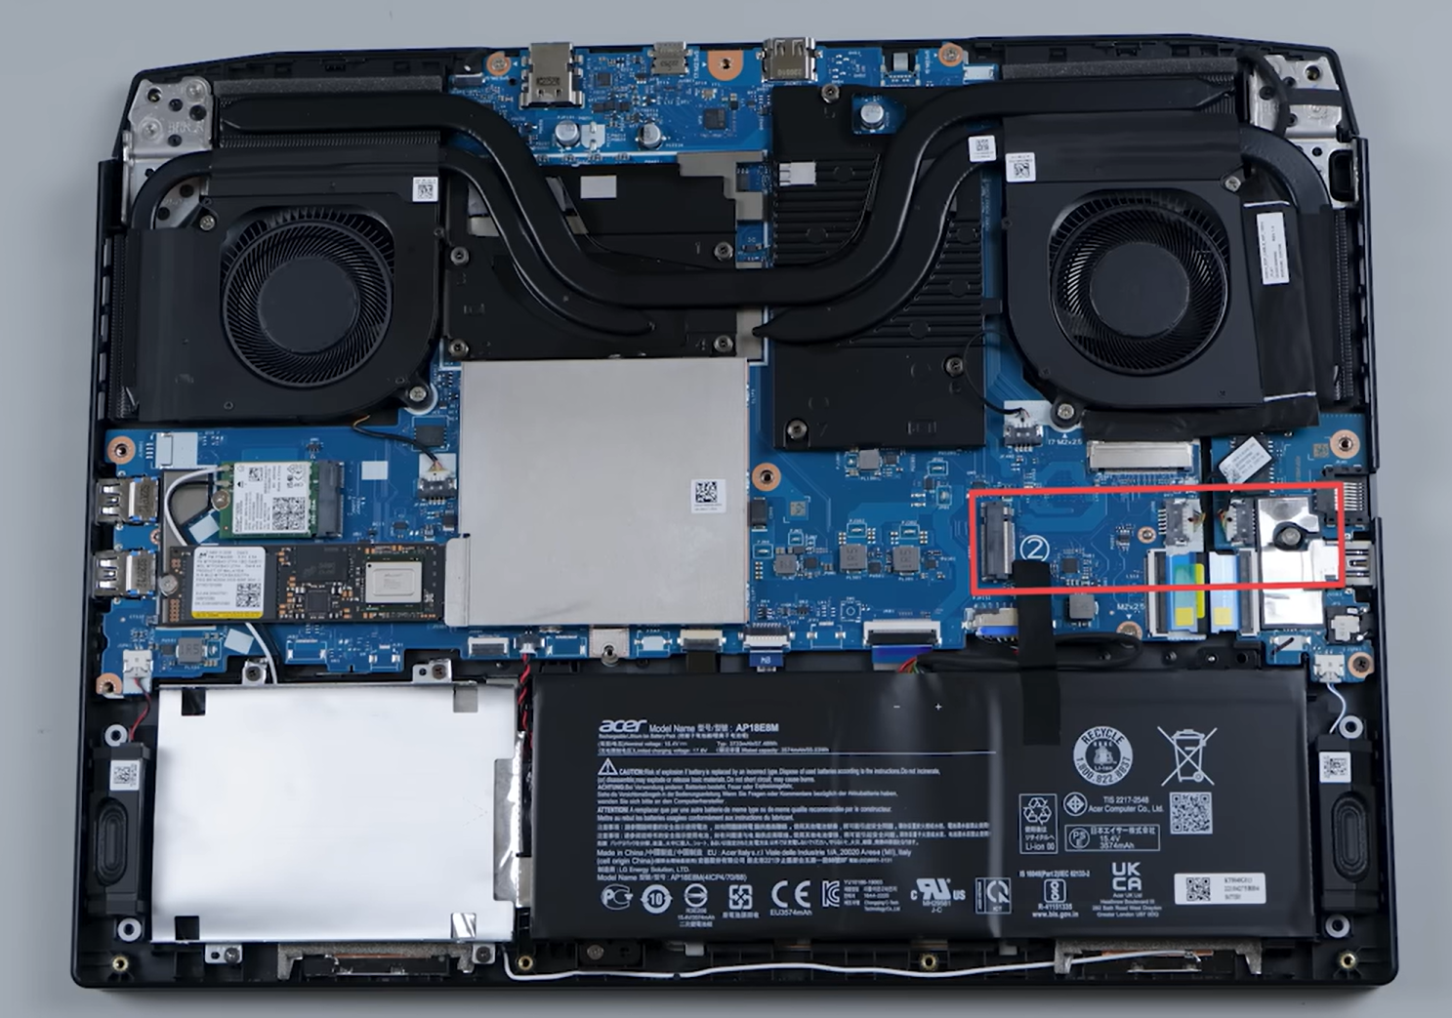
SSD
512GB SSD NVMe M.2
Pcle 4.0
Tersedia slot M.2 Kedua
Tersedia Juga slot Storage SATA
Mendukung triple storage

Slide 8
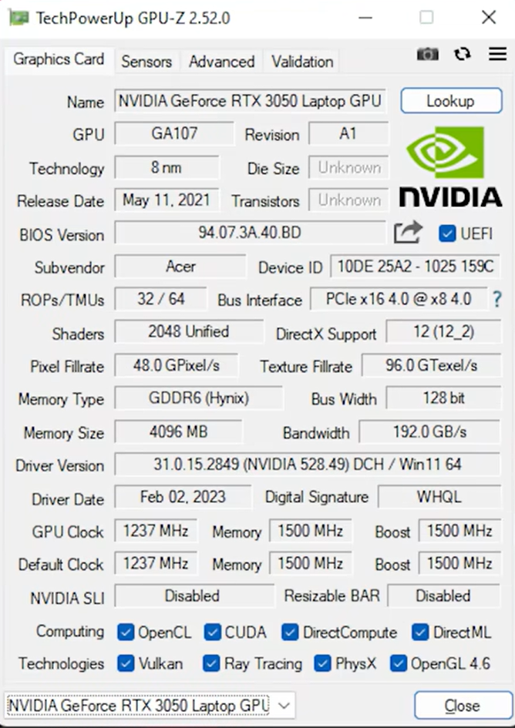
GPU
NVIDIA® GeForce RTX™ 3050 Laptop GPU
4 GB GDDR6 VRAM
2048 CUDA Cores
Default TGP di 60W
Max TGP di 95W

Slide 9
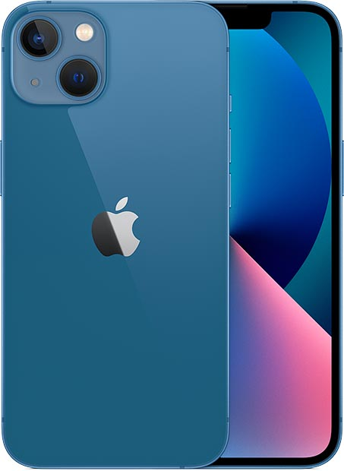
IPHONE 13
Reguler

Slide 10
Spesifikasi Iphone 13
OS
Memory
iOS 15, upgradable to iOS 17.0.3
128GB 4GB RAM NVMe
Battery
Chipset
Li-Ion 3240 mAh
Apple A15 Bionic (5 nm)

Slide 11
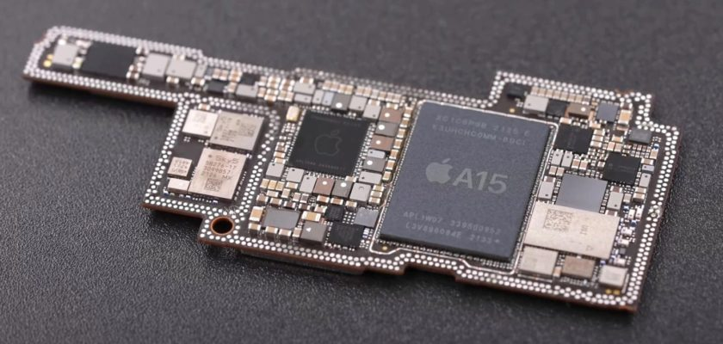
Spesifikasi Iphone 13
Processor
CPU Apple A15
Hexa-Core (2x3.32 GHz Avalance + 4x1 GHz Blizard)
Speed 3230 MHz
Microarchitectur Bionic
Core Acount 6
Active Core Count 6

Slide 12
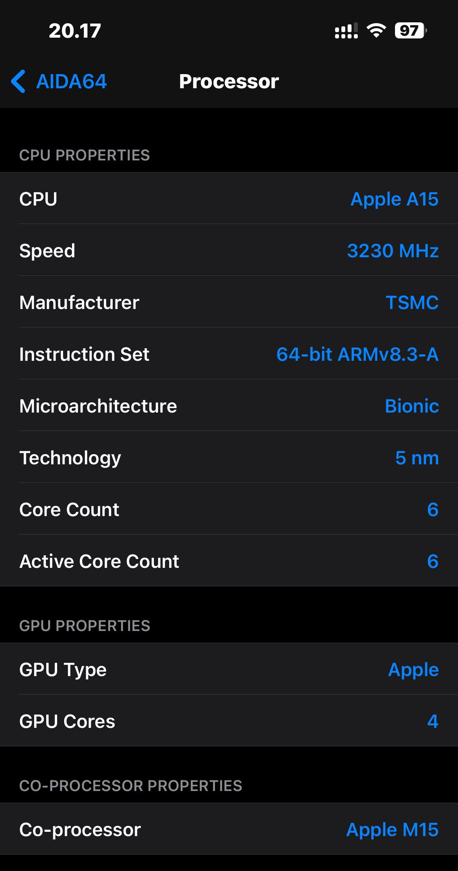
GPU
GPU Type Apple
GPU Core 4 Graphics

Slide 13
SEKIAN & TERIMA KASIH

